Slide 1
Data-driven overdose prevention
Session II – October 24 3:30 – 5:00 p.m.
Ventura County’s “NO-OD” Program
Loretta Denering, DrPH, MS
Division Chief and Workshop Moderator

Slide 2
Today’s Panel
Will discuss how an opioid overdose prevention program began as a pilot project, and evolved over four years as a data-informed community health project using best practices on a tight budget
Dr. Loretta Denering, Chief, Alcohol and Drug Programs VCBH
Dan Hicks, Prevention Services Manager, VCBH ADP
Kim O’Neil, Executive Director, Project SAFER
Dr. Kristen Donovan, President, EVALCORP

Slide 3
Disclosures
All participants in today’s workshop have no relevant real or apparent personal or professional financial relationships with proprietary entities that produce health care products, goods or services.
No conflicts or financial interests to disclose

Slide 4
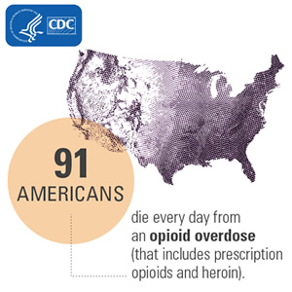
National Overdose Epidemic
Deaths from drug overdoses have been the leading cause of injury death in the United States since 2012, surpassing motor vehicle accidents by 50%!
* More than 72,000 Americans died from drug overdoses in 2017, including illicit drugs and prescription opioids– a twofold increase within the last 10 years.
Notes:
Source: CDC Policy Impact Prescription Drug Overdoses, 2011

Slide 5

California Overdose Crisis
21,787,042 -Opioid Prescriptions statewide, in 2017
4,281 -Opioid (non-heroin) Overdose ED Visits, 2017
429 -Fentanyl Overdose Deaths, 2017
2,196 -Opioid Overdose Deaths, 2017

Slide 6
Workshop Objectives
Participants will be able to:
Describe how partners/agencies work collaboratively to develop a successful community-wide overdose prevention plan at the local level.
Identify strategies and challenges for implementing a similar program in their jurisdiction(s).
Describe the importance of incorporating evaluation data collection; and document outcome measures, and important cultural differences related to effective outreach.
Notes:
The theme of this conference is “Disruptive Innovations and Sustaining Change,” and apt theme as you will see

Slide 7
Beginnings of Ventura’s NO-OD program
Dan Hicks
ADP Prevention Services

Slide 8
Ventura County Responds
Addressing Twofold Epidemic of Rx Painkiller and Heroin Abuse
The Ventura County Rx Abuse & Heroin Workgroup was developed in early 2012 in response to the escalating opioid epidemic, part of a crisis that crosses boundaries and demographics.
Opioids have been most widely-prescribed painkillers for years,
Heroin is illegal street opioid, lower cost for a comparable high
Both are extremely addictive, driving the transition for many prescription opioid abusers to the cheaper, more readily available heroin. Both must be addressed.

Slide 9
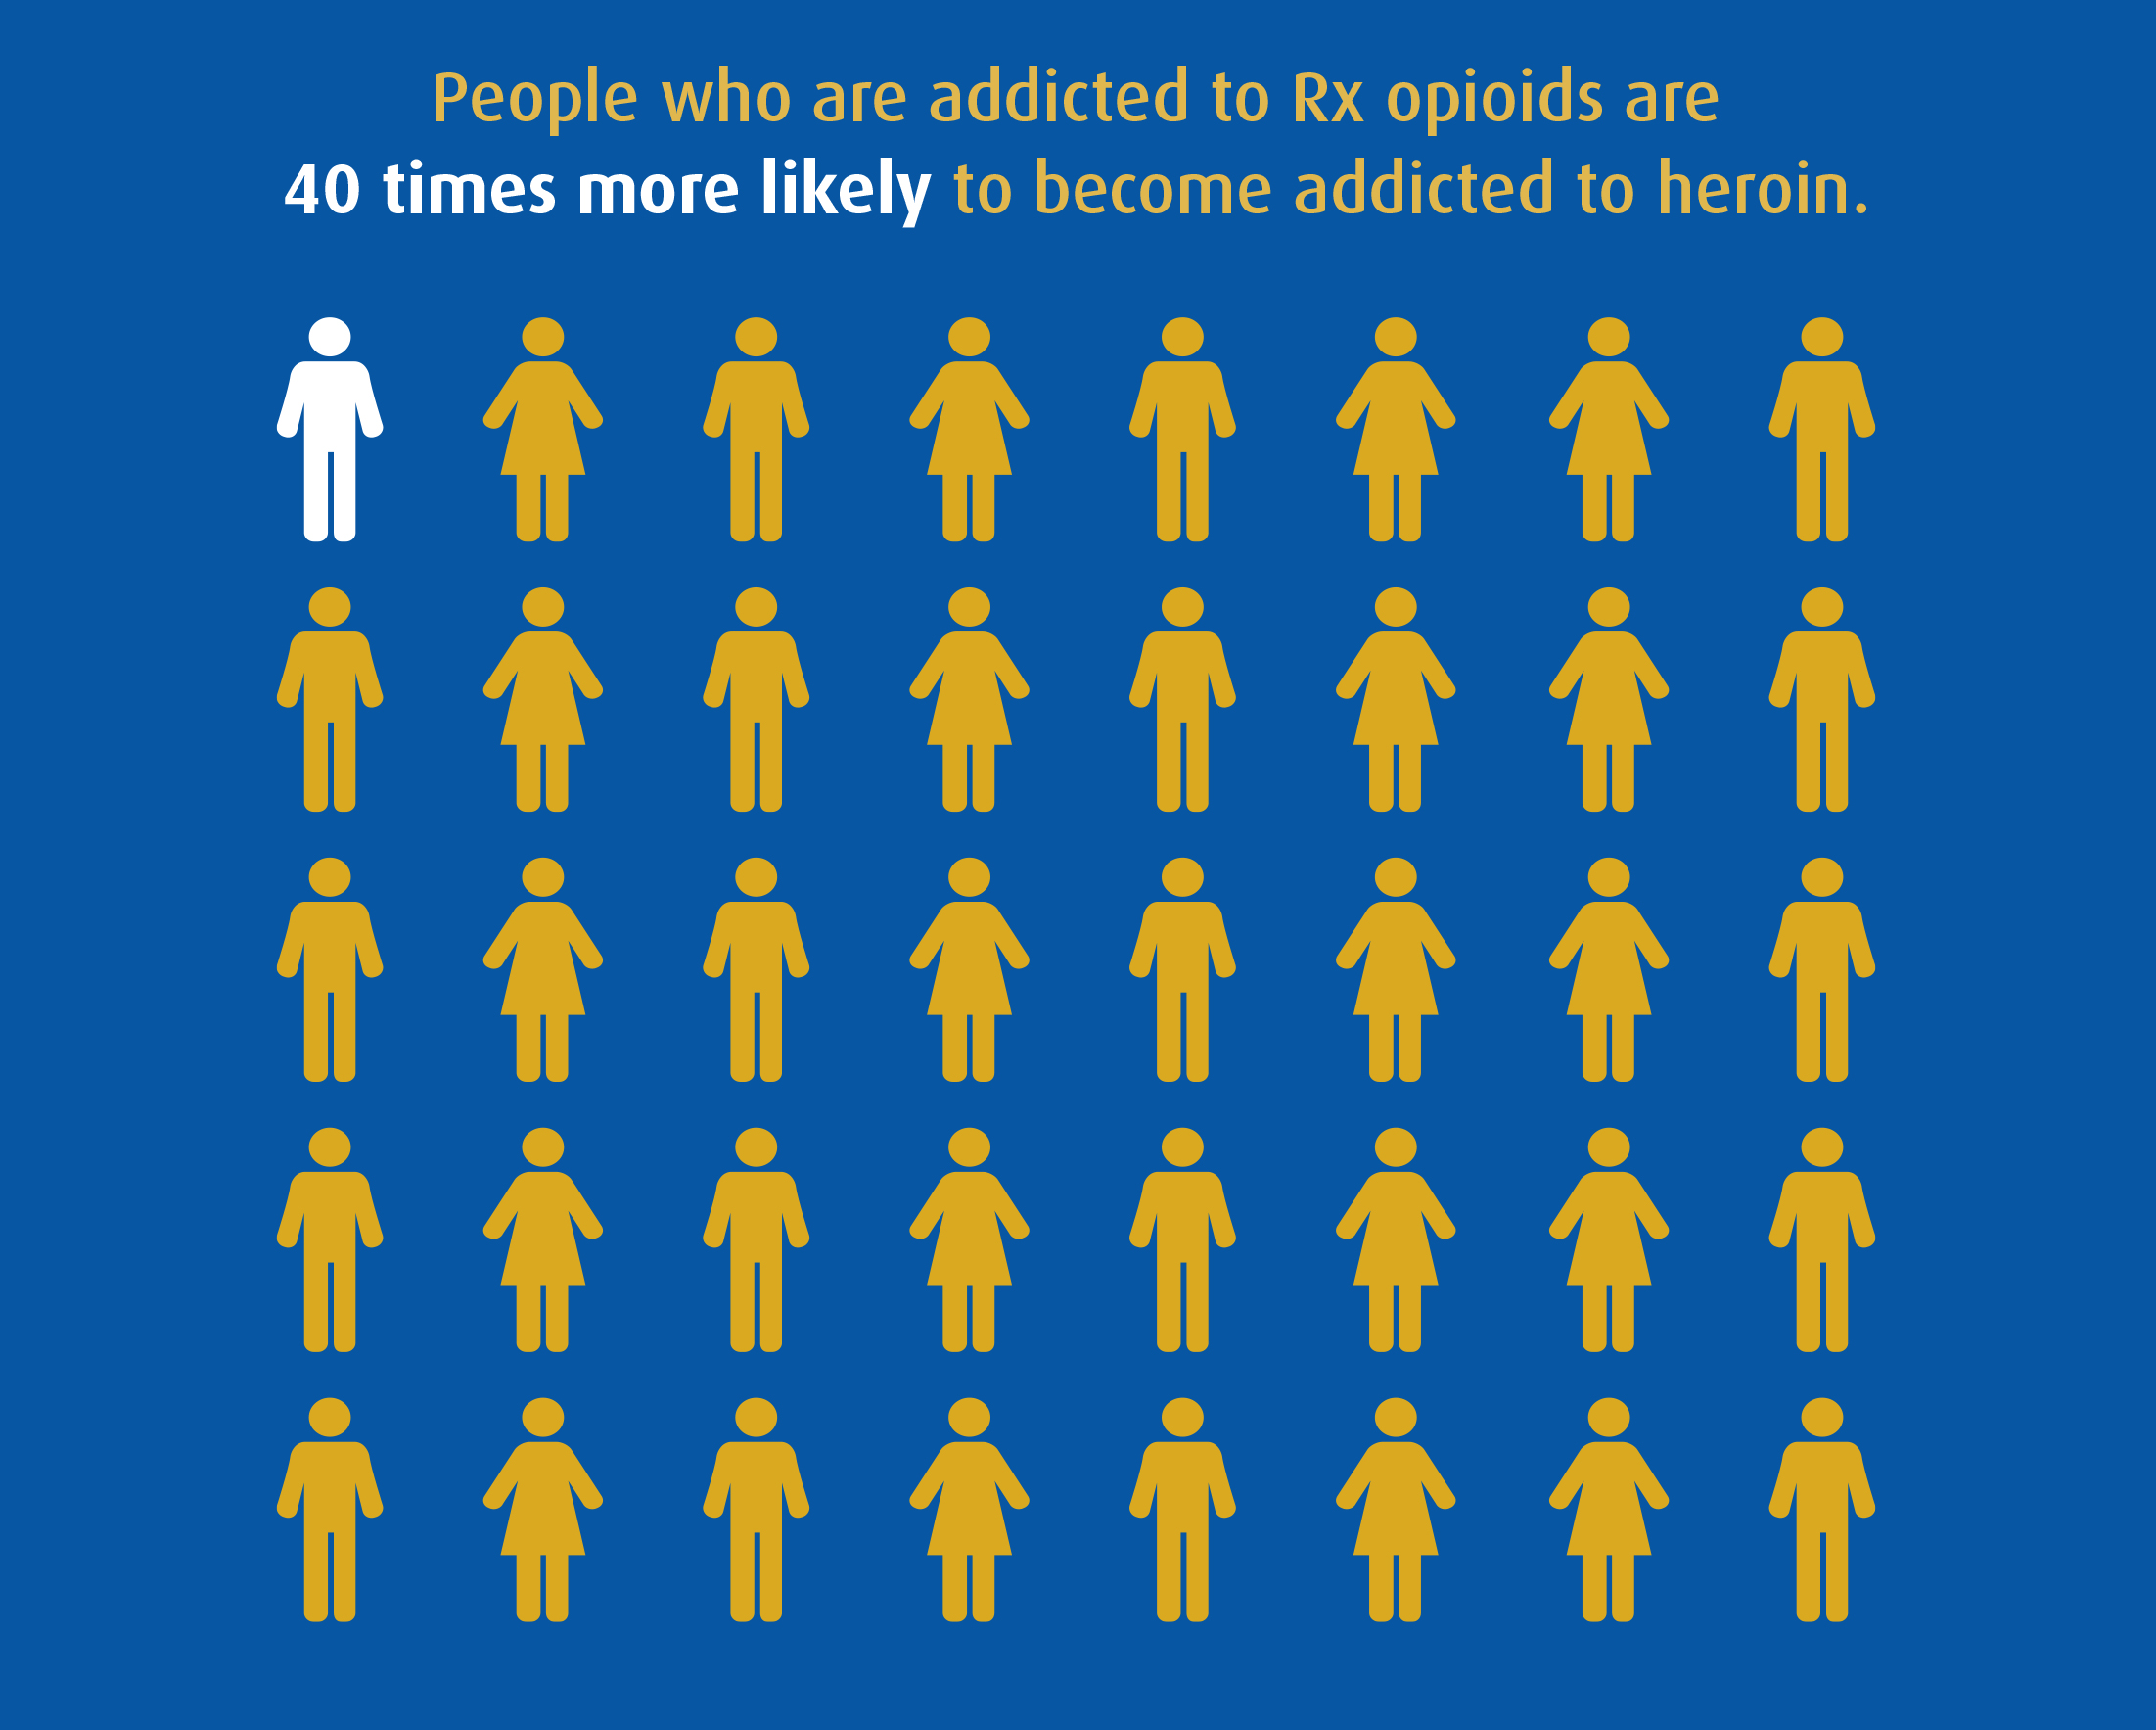
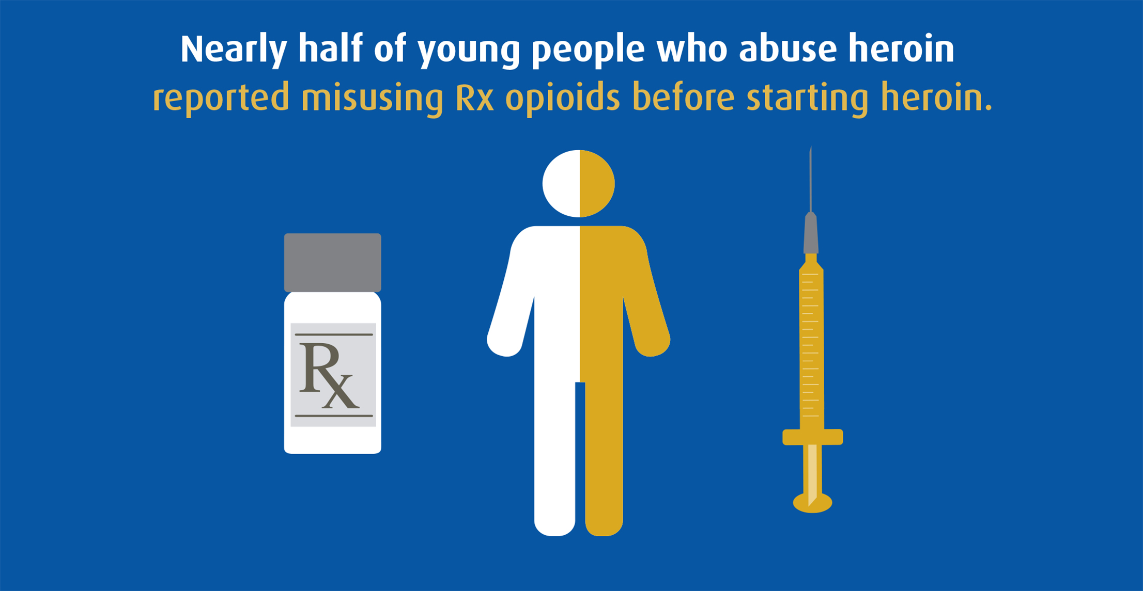
A Two-Fold Problem

Slide 10
Rx Abuse and Heroin Workgroup
MISSION: Save and improve lives by stopping Rx drug and heroin abuse.
PRIMARY GOAL: Decrease fatal opioid overdoses by 50% in Ventura County, compared to 2013 baseline.
CRITERIA FOR GOALS:
The selected goals and actions reflect:
Data-indicated problems Defined scope and reach
Measurable efficacy Achievability
Crosscutting strategies Cultural and linguistic relevance
Sensitivity to stigma

Slide 11
Most professionals understand…
Significant stigma associated with heroin and opioid overdose prevention & naloxone distribution
  Even though it’s relatively cheap, safe and effective
Most early programs used intramuscular injection because that was the form most easily available
  Contributing to fears of law enforcement, other risks
Nasal naloxone has been a game-changer in terms first responder attitudes and lay naloxone OD prevention work

Slide 12
Significant hurdles for project today
How do you provide standardized OD response training for highest risk people, reaching those in a position to identify and take action to reverse effects of opioids?
Who will carry out systematic data collection on naloxone kits and their use in the community to effectively respond?
How can data be used for both formative and summative evaluation purposes for continuous improvement?
Notes:
Most counties do not have OD response and naloxone training built into their CPR/Lifesaving training requirements

Slide 13
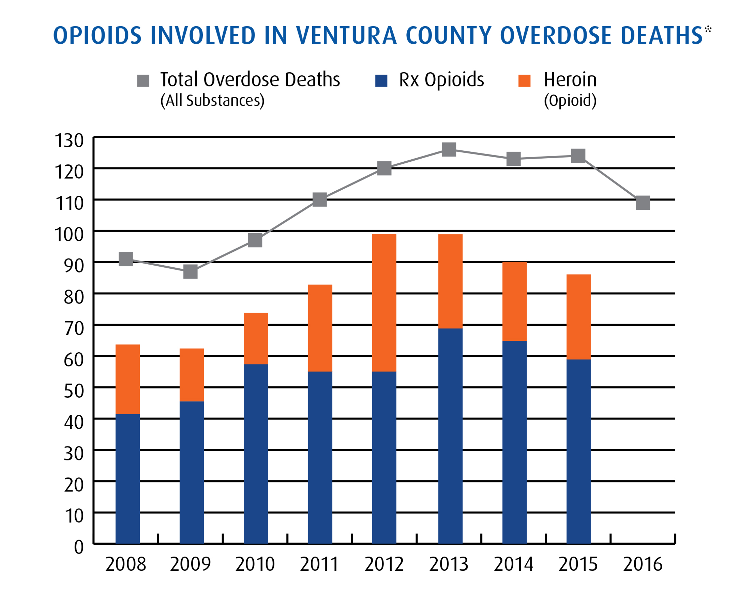
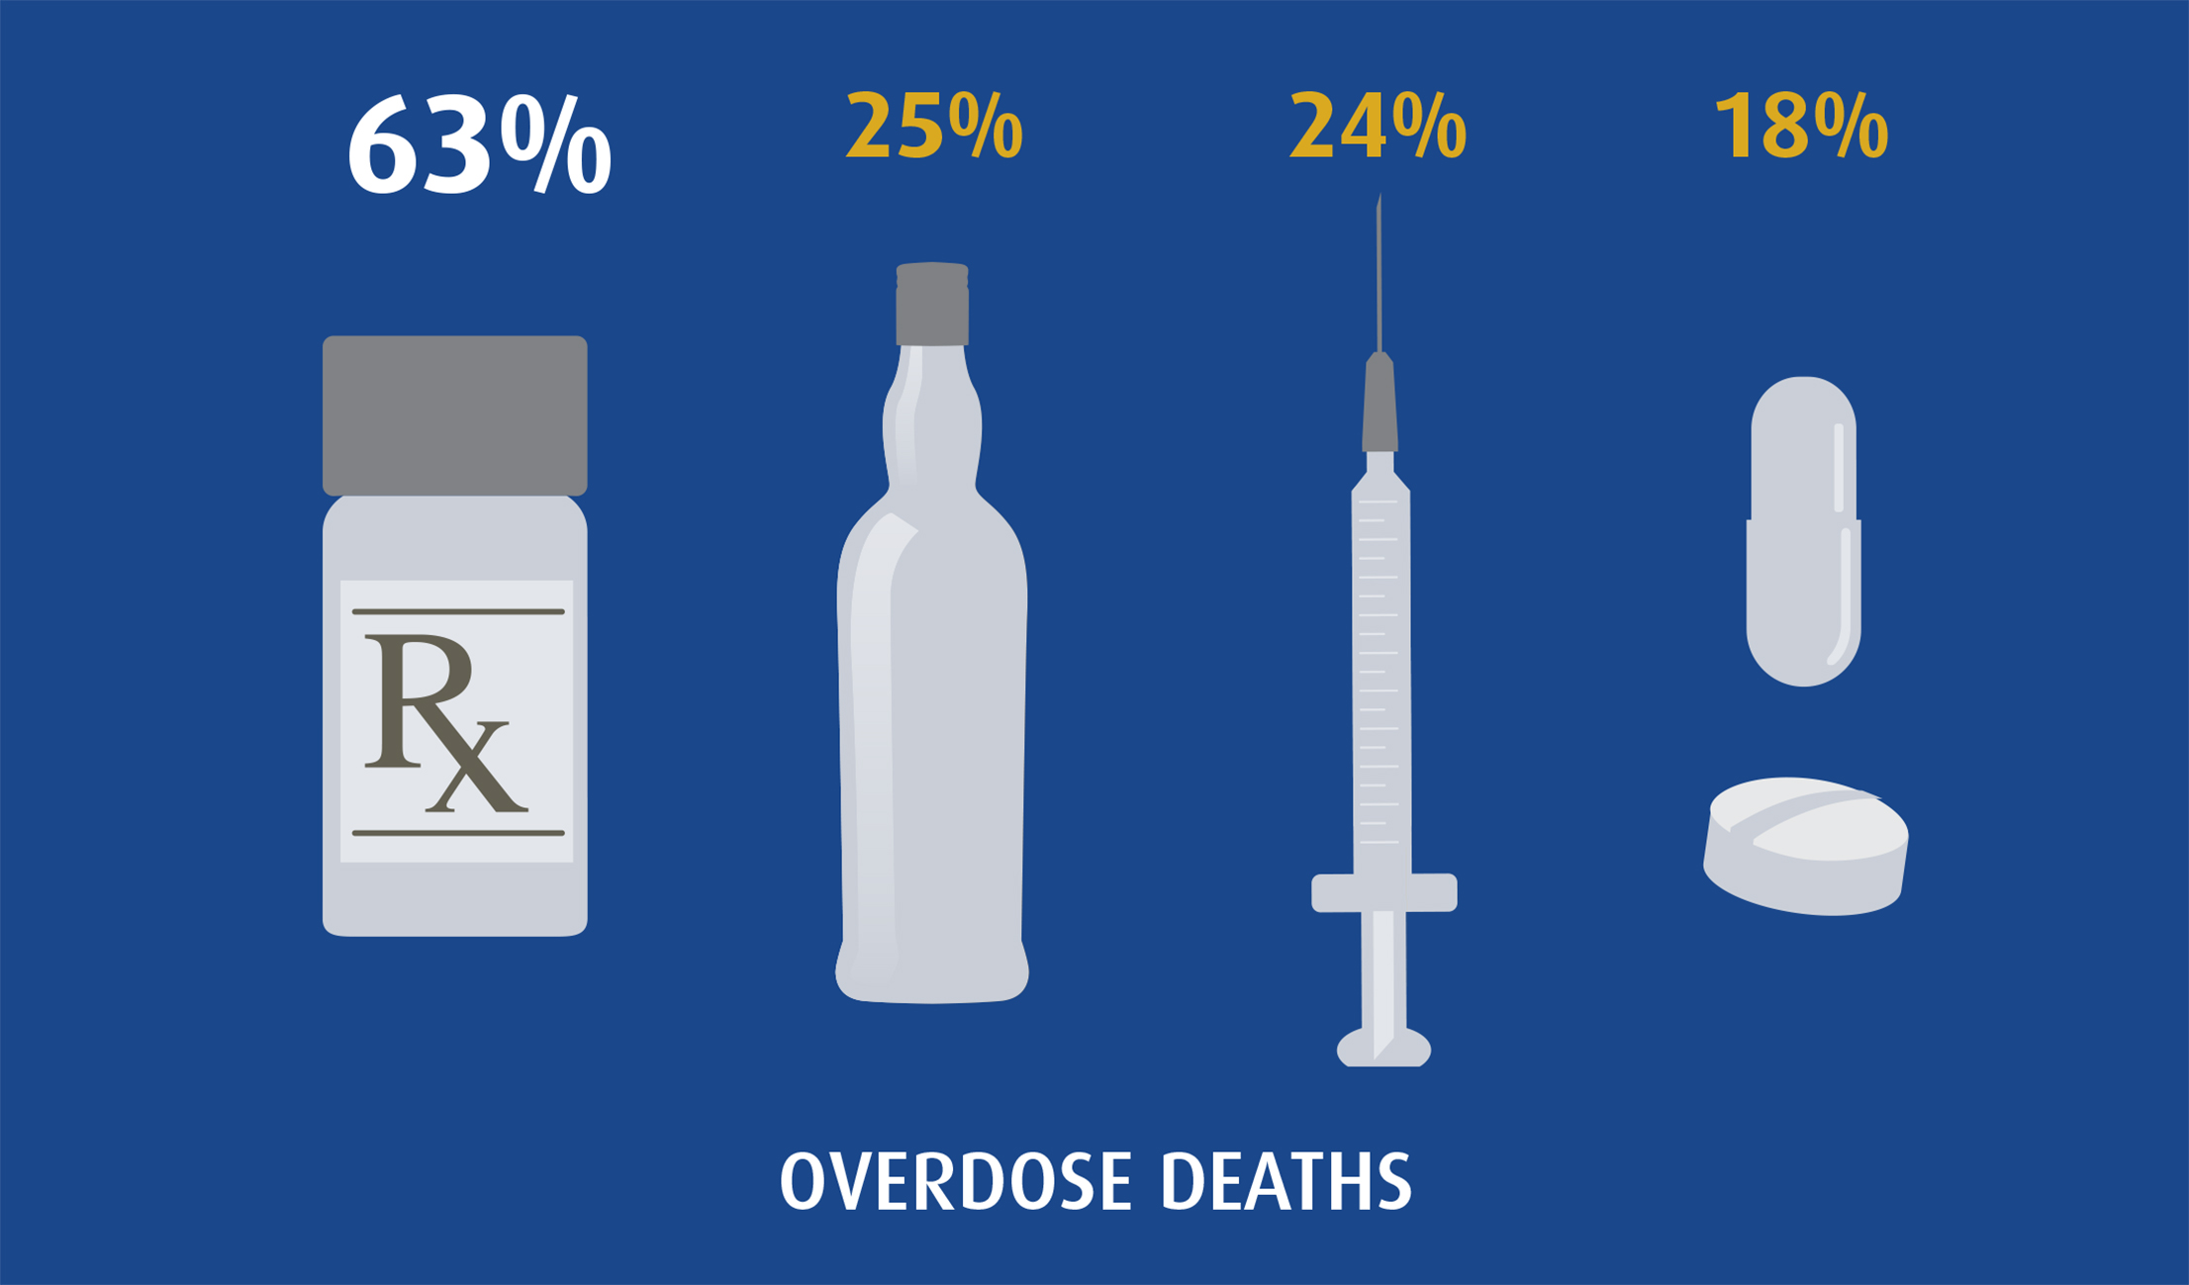
Local Data
Select findings from Ventura County Overdose Deaths 2008-2015
Rx drugs account for most overdose deaths (63%), far above other substance categories (25% alcohol-related, 24% heroin-related, and 18% illicit drug-related).
The majority of overdose deaths were opioid-related, either heroin or opioid Rx drugs.
Most overdose deaths were due to the use of multiple substances: 68% consumed two or more different substances. Only 32% of overdose deaths were related to an overdose of one single substance.
Notes:
2008 15%
2009 22%
2010 24%
2011 14%
2012 14%
2013 20%
2014 15%

Slide 14
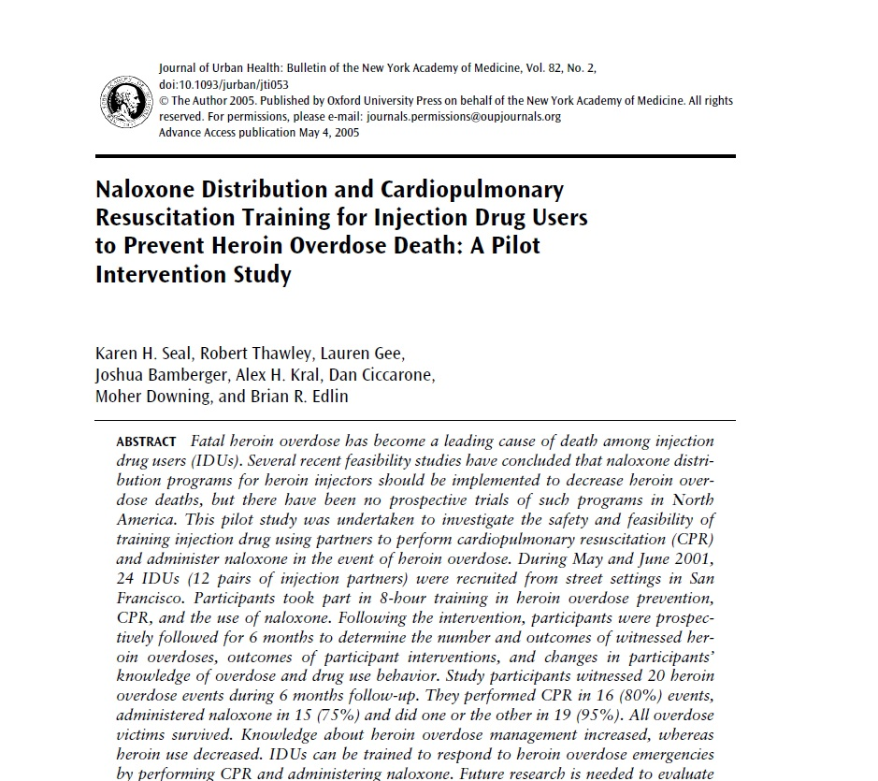
Research supported this direction: Eliza Wheeler, Dr.Davidson, others
2005 – 2012, mounting research on safe and effective response
“Research shows marked decreases in OD mortality”

Slide 15
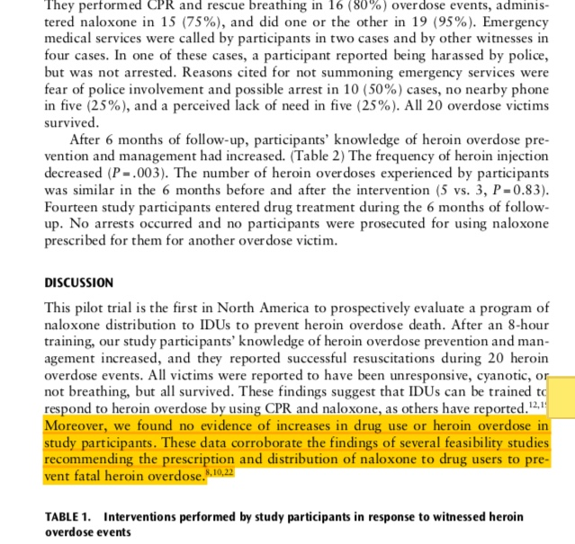
AND…Importantly:
No evidence of increases in drug use or heroin OD
Seal, et. al., 2005
Journal of Urban Health: Bulletin of the New York Academy of Medicine, Vol. 82, No. 2

Slide 16
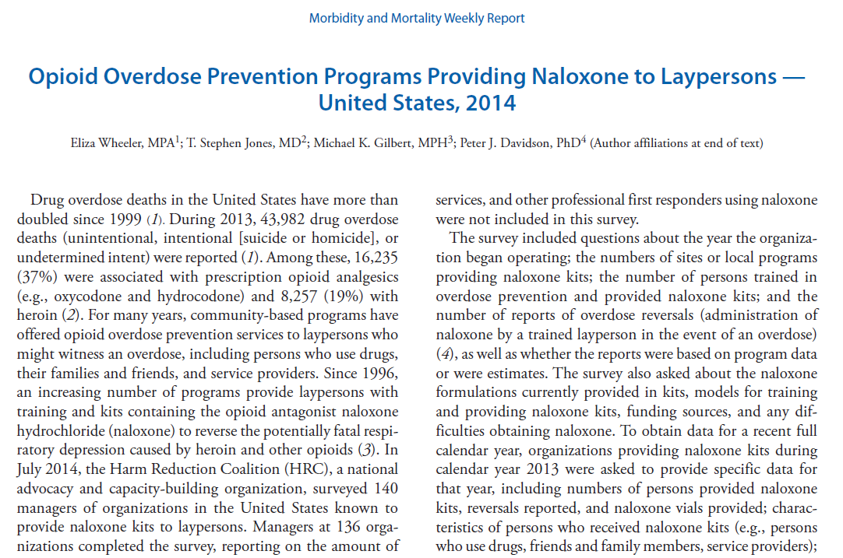
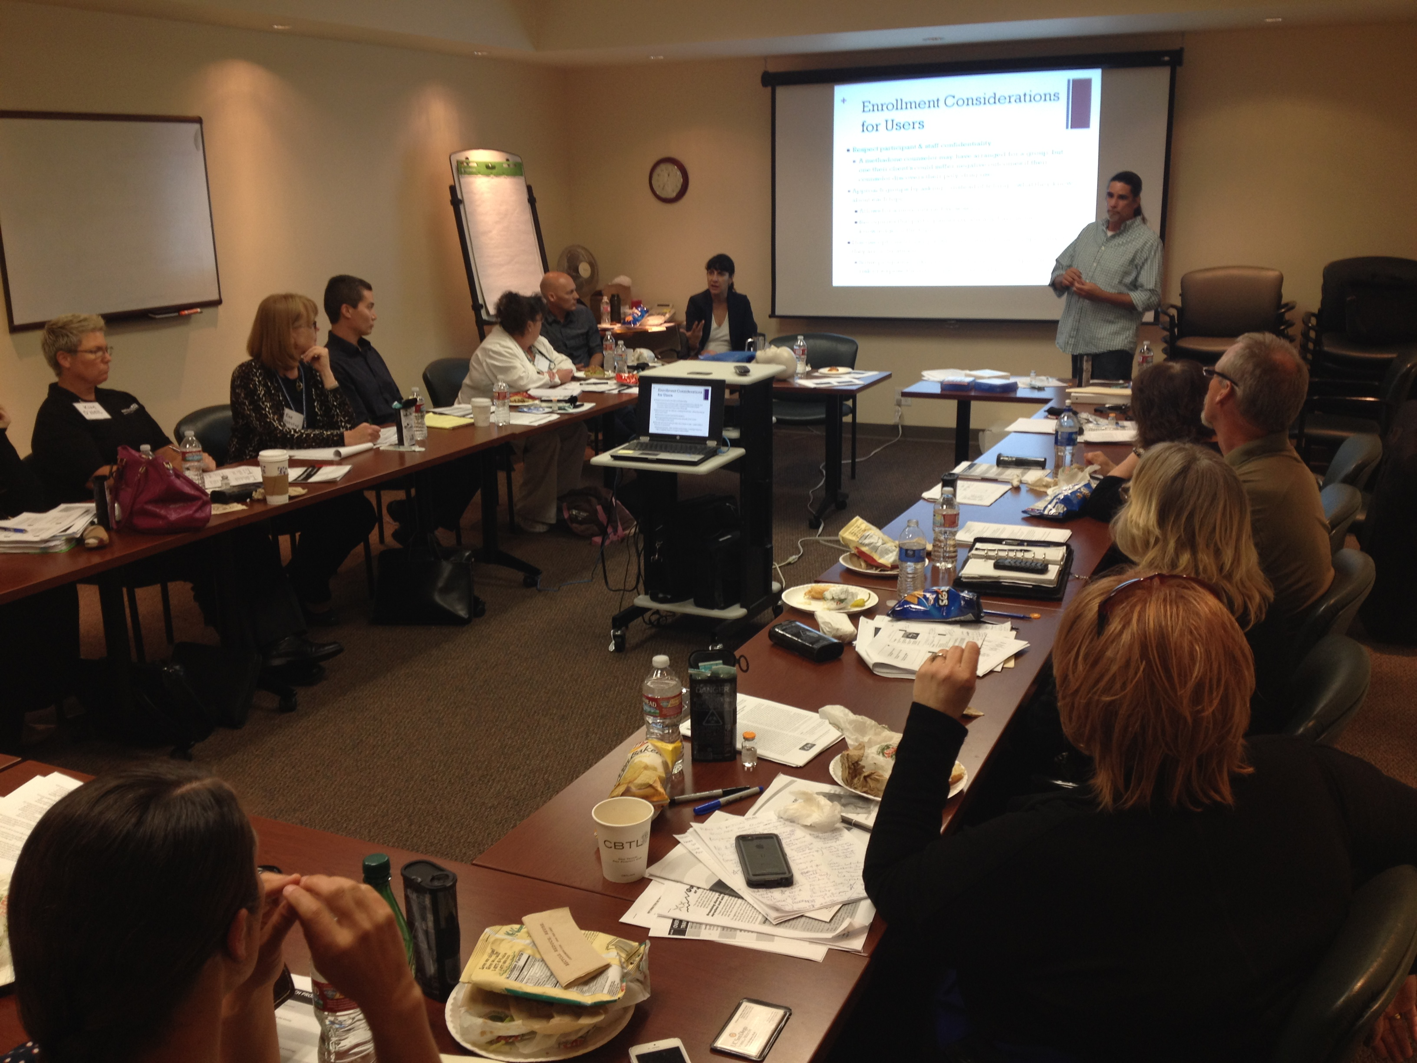
Went to School: OD Prevention & Reversal

Slide 17
Overdose Prevention Pilot Program
Rx Abuse and Heroin Workgroup- strong interest, but less than $50K in unrestricted funds to apply to effort
Needed to target the groups at elevated risk
Began as pilot program at 6 sites → just 150 kits (300 vials)
Early Goal: reach 150 family, friends, and loved ones with training on overdose prevention
Now expanded to 33 sites, 2500+ kits with modest grant of additional $52,000 for additional naloxone kit supply
Distinguishing Feature: Built in data collection from start

Slide 18
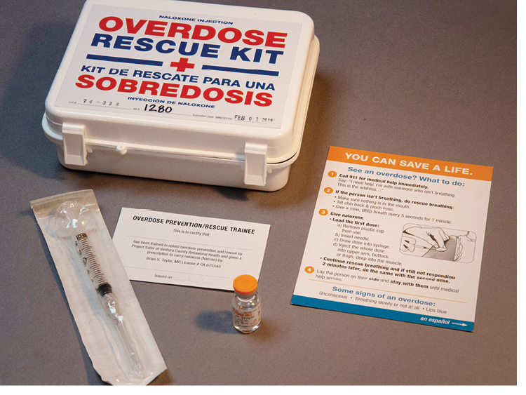
Initial Kit Design
Looks like First Aid kit
English and Spanish
2 vials and 2 IM needles
Branded instruction card
Complete initial form

Slide 19
Taking the pilot to scale
Kim O’Neil
Project SAFER

Slide 20
Challenge: inventory control
Local protocols for tracking and logistics
Detailed and accurate accounting for kits, supplies
Added storage space, inventory
Increased staffing needs
Cross checks on kits, lot numbers, expiration, etc.
Implemented detailed inventory procedures, within SAFER and across dozens of training sites

Slide 21
Success: improving kit designs
Started with First Aid Kit IM model
Smaller, more portable sharps kit model
Bank bag with medication and kit tracking system
First responders – adapted to needs of department policy
Moved from ZERO agencies in 2014, to nearly
all jurisdictions trained and equipped in 2018

Slide 23
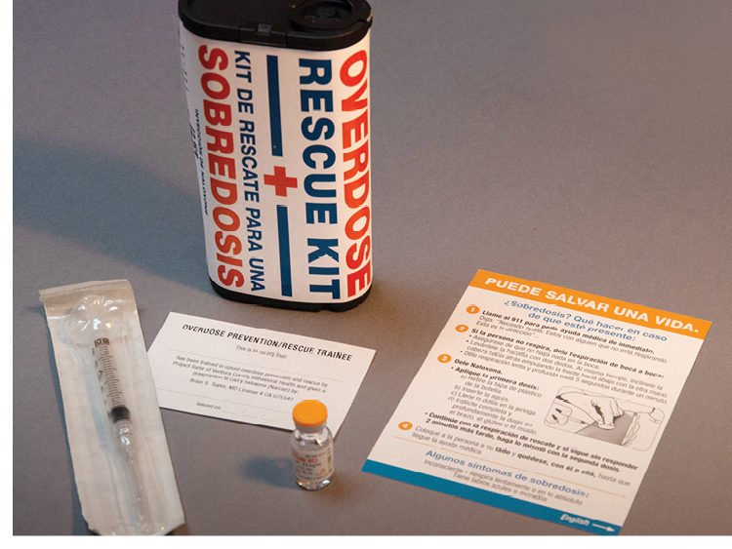

Slide 24
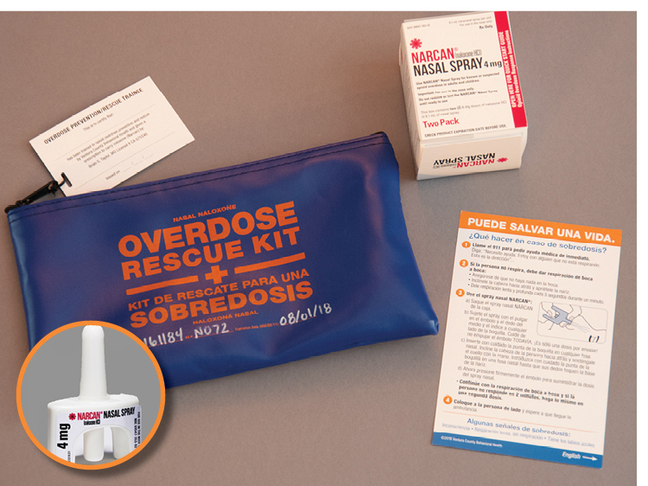

Slide 25
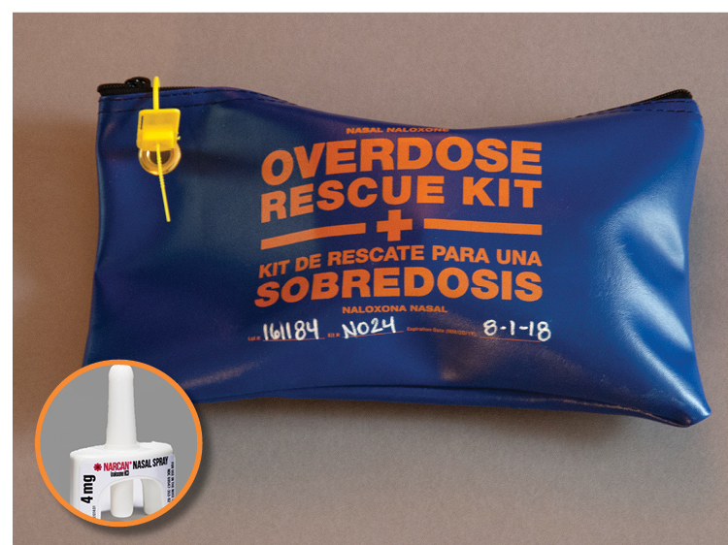

Slide 26
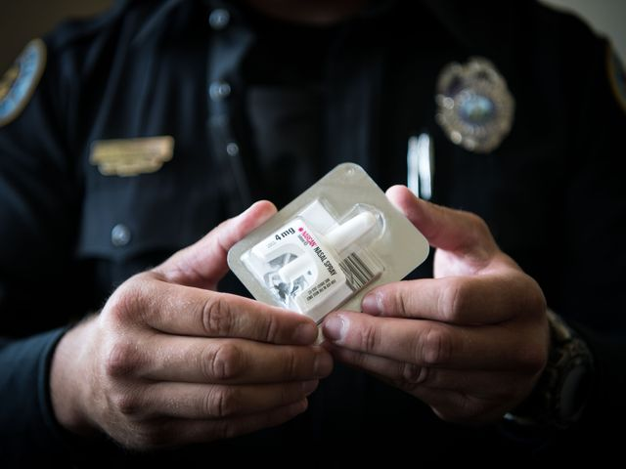
Relationships with Law Enforcement

Slide 27
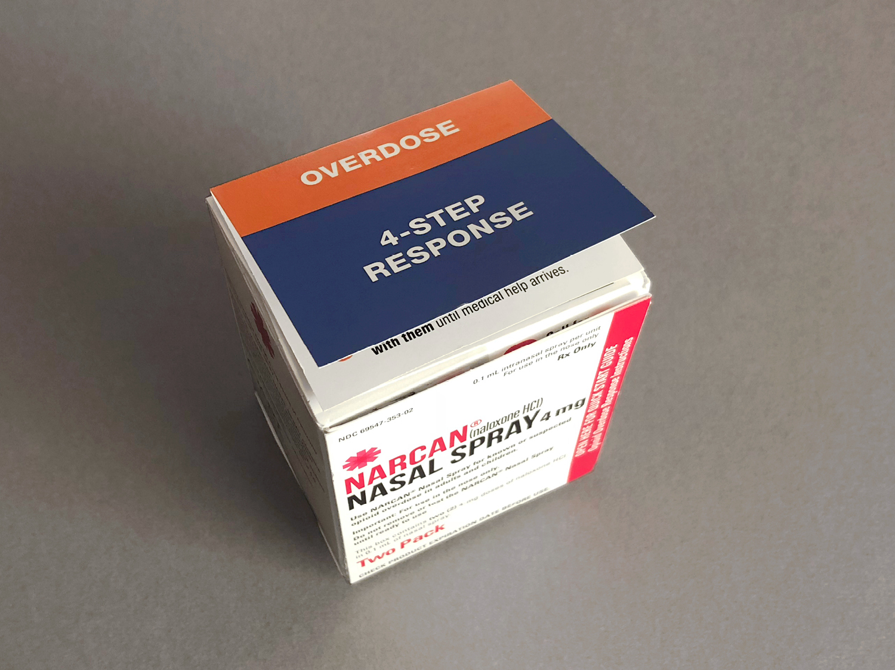
Law Enforcement First Aid Bag
Part of updated ready bag
4-step response attached
2 nasal Narcan bottles
Simple data agreement
Ties to full incident report

Slide 28
Success: Stigma reduction messaging
Generating community discussion, acceptance
Branded “NO-OD” materials, English/Spanish
“Naloxone Saves” campaign:
  Newsprint, handouts
  Billboard, posting boards
  Movie theatre ads, even the DMV
Culturally informed messaging
Begin normalizing discussion of OD response

Slide 29
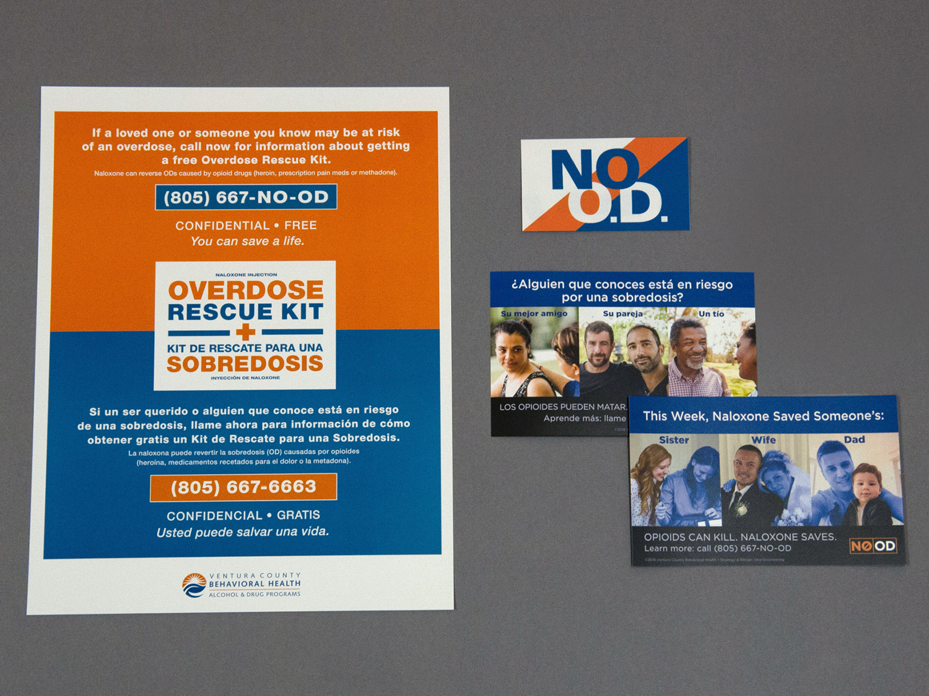

Slide 30
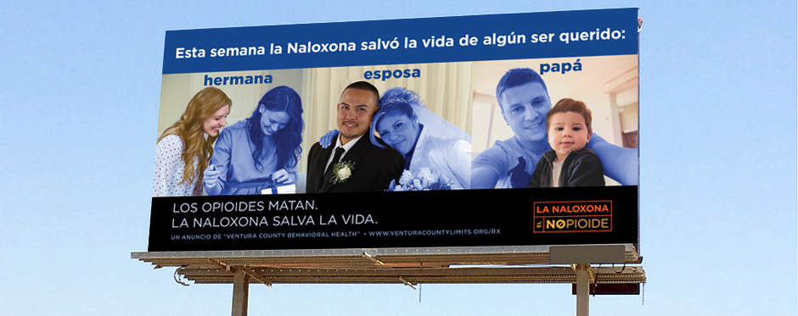
“This week, Naloxone saved someone’s..”

Slide 31
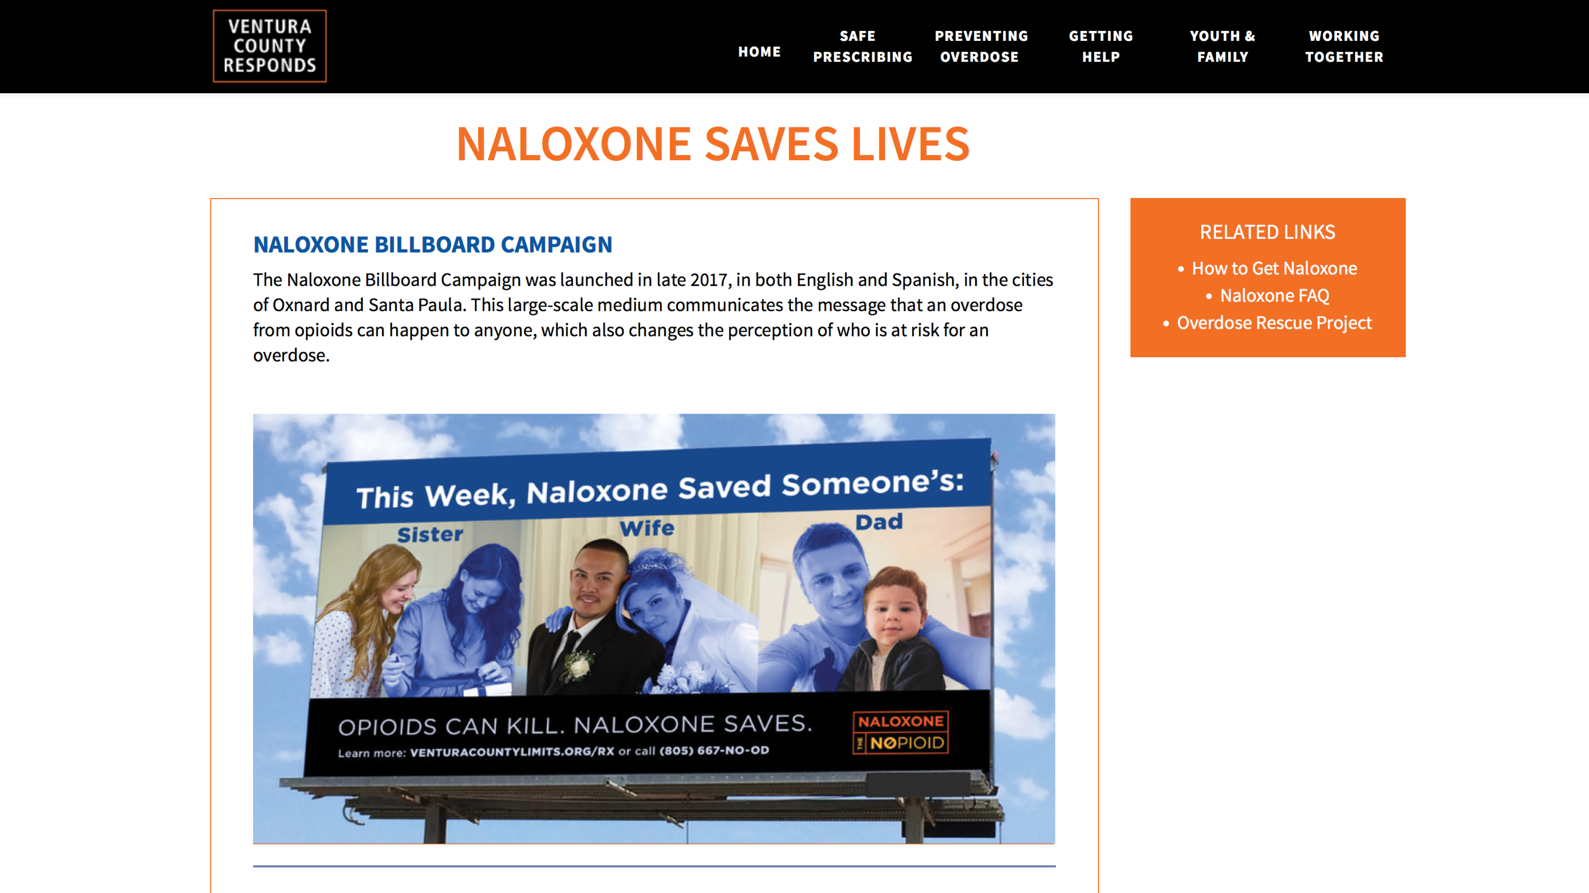

Slide 32
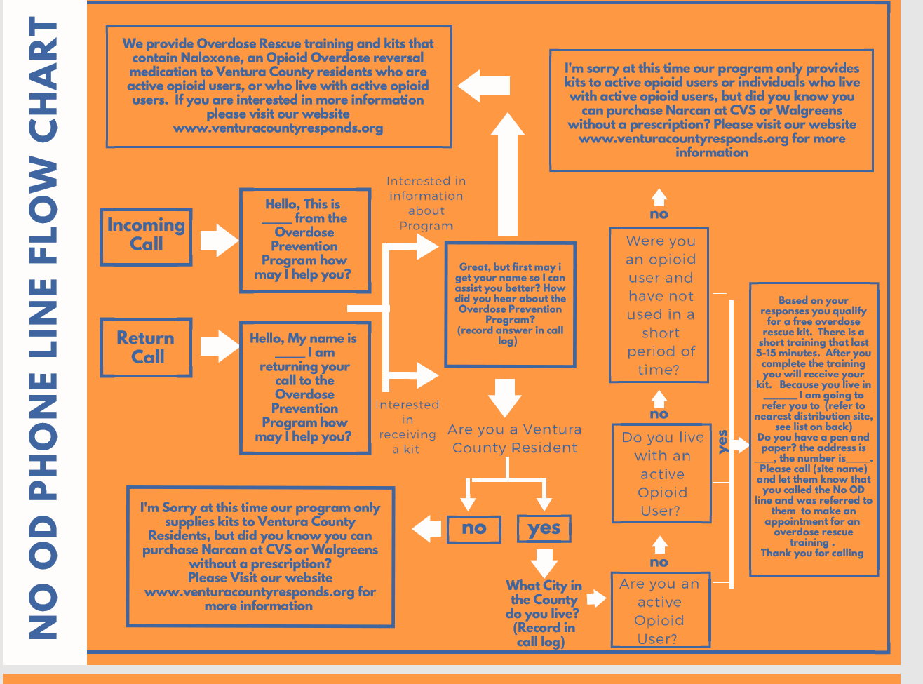

Slide 33
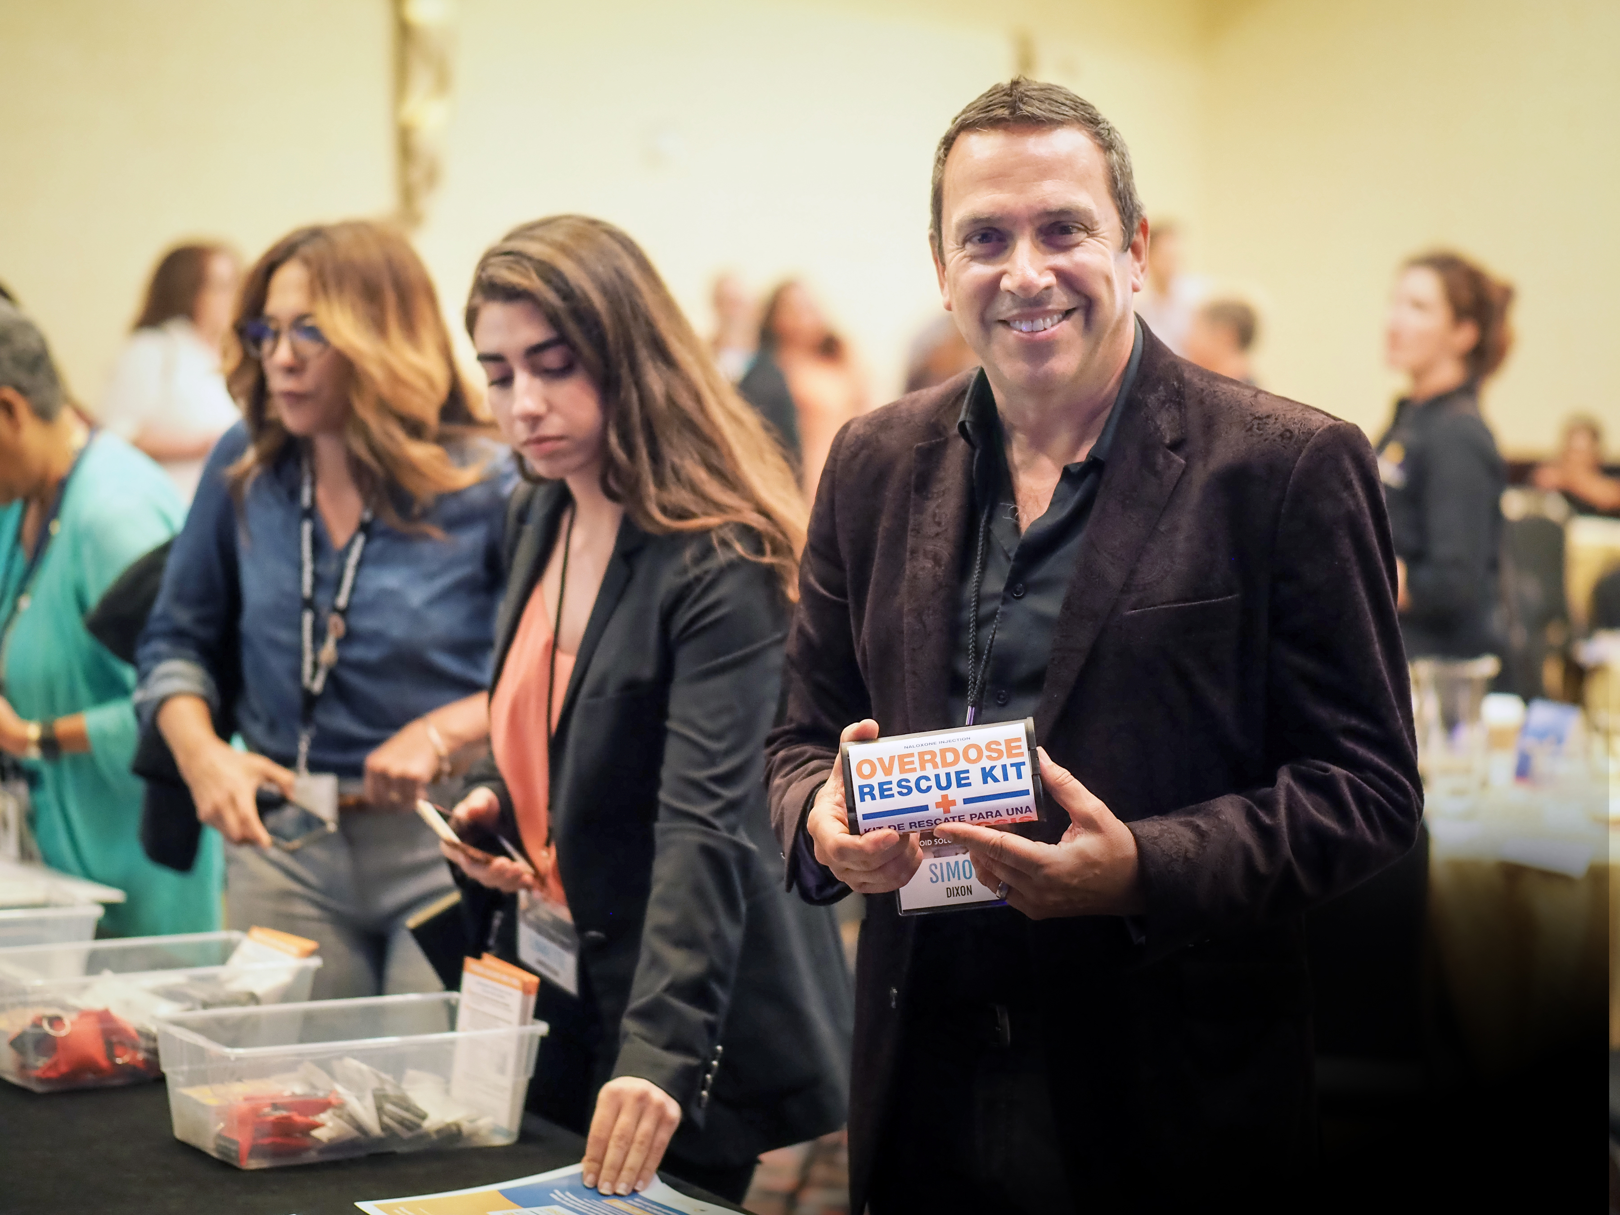
De-stigmatizing

Slide 34
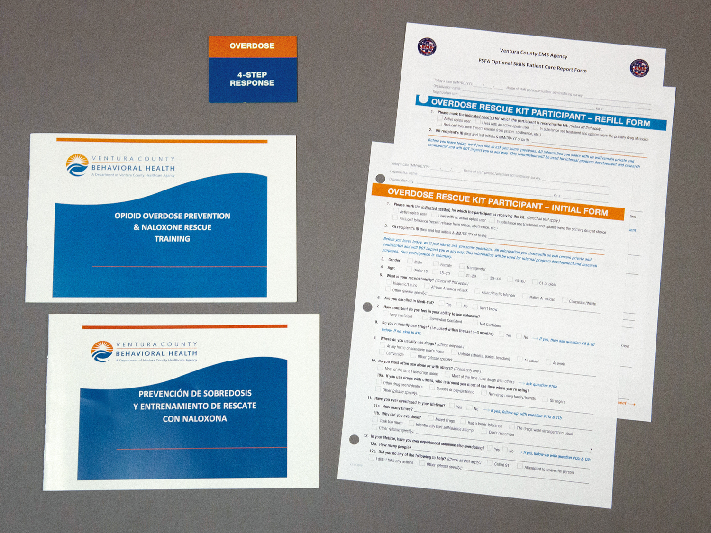

Slide 35
Data Collection
Tools:
  Initial Form collected from all participants who receive training and a naloxone kit
  Refill Form collected from all participants who come back for a refill
Procedures:
  All participating agencies/staff trained to ensure systematic data collection
  Forms are administered by program staff
  Collected on a regular and on-going basis

Slide 36
Success: Data Quality
Refined policies and practices for good data
With more volume, more counselor check-ins on quality
Centralized data input identified errors, feedback needs
Specialized and timely ‘remedial’ training for good data
“Bad data can be worse than no data at all”
Never lose focus on data collection and quality, the sustainability of the program depends upon them

Slide 37
Applied Research
Dr. Kristen Donovan - EVALCORP

Slide 38
Initial Forms
1,909 Kits Distributed at 33 Sites Across the County
Initial Form Assessment Captures:
Overdose history
Demographics of persons receiving kits
Drug use patterns
Comfort level with administering naloxone
Participating Sites: county alcohol and drug programs, public health SRPs, and mental health providers
Notes:
10/15/14 to 09/26/18
Public Health includes SRPs

Slide 39
History & Experiences with Overdose
Witnessed Someone Else Overdose (1,735) | 78% reported having witnessed someone else overdose at least once in their lifetime Average of 5 overdoses witnessed
Respondent Overdosed in their Lifetime (n=1,735) | 46% reported having overdosed at least once in their life Average of 3 overdoses experienced
Notes:
Average of 3 overdoses experienced in their lifetime

Slide 40
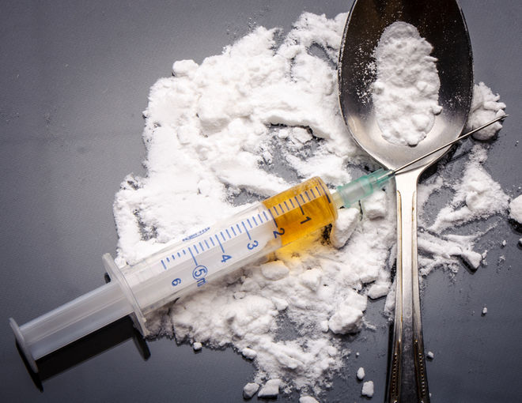
Reason for Overdose*
*Calculated for those having overdosed themselves and who provided one or more reasons for having overdosed. Percentages exceed 100%, as respondents could select more than one response.
Notes:
Self harm and “other” response options combined into “other”

Slide 41

Kit Recipient Demographics
(n=1,735)
Gender
Race/Ethnicity* | Drug Use Status: 56% active users of illegal drugs
Male
59%
Female
41%
White/Caucasian
54%
Hispanic
45%
Other Races
7%
*Percentages exceed 100%, as respondents could select more than one response.

Slide 42

Drug Use Patterns Among Current Users (n=513)
67% of “active users” reported using drugs at home or someone else’s home
Drug Use Partners (Top 3 Responses)*
71% - drug users/ dealers | 46% - use alone | 40% - with their significant other
*Percentages exceed 100%, as respondents could select more than one response.
Notes:
2nd most frequently selected drug use location was “outside” -- 29% reported using drugs outside (e.g., streets, parks, benches).

Slide 43


Enrollment in MediCal
(n=1,396)
81% were enrolled in MediCal
17% were not enrolled
2% did not know

Slide 44
Overdose Prevention Program
Refill Forms
553 collected across 21 sites

Slide 45
Reason for Refill
(n=553)

Slide 46

Outcome of Using Naloxone
Nearly 400 Lives Saved!
384 overdose reversals to date
Notes:
Naloxone used in 398 overdose events. Out of the reported 398 events where naloxone was used, 384 were reversals were observed (i.e., the naloxone worked/the person woke up). In 14 instances, the paramedics came and revived the person, the participant didn’t know what happened, and in 2 instances, the person was deceased.
In the one instance, the person was already deceased; however, kit recipient still tried to use the kit to revive the person.

Slide 47

Background of those who Overdosed
(n=398)
Gender
Most common reported drug taken: 98% Heroin
Male
72%
Female
28%

Slide 48
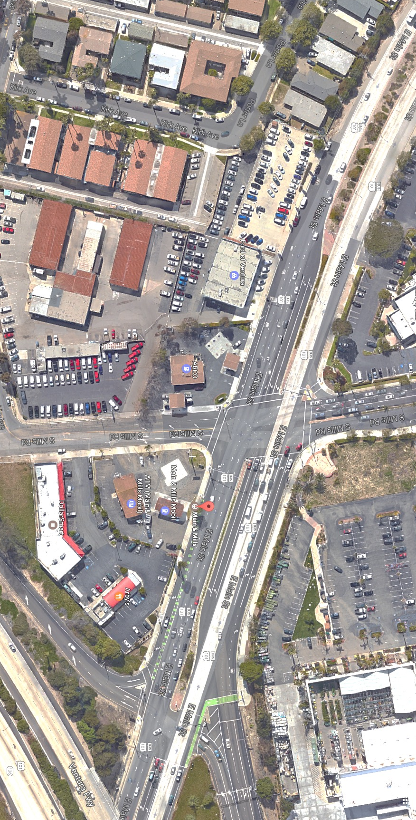
Where Overdoses Occurred
#1 Reported Intersection of Overdose:
Main Street & Ventura Ave. (Ventura)
Location: 56% reported overdose event occurred at a private residence
Zip Code of Overdose (Top 3)
93001 | 93030 | 93003

Slide 49
Impact on Drug Use
Question: Overall, what impact has participating in this program had on your drug use?

Slide 50
Local Results – As of September 2018
2,558 Overdose Rescue Kits Distributed
33 Distribution / Education Sites
374 Overdose Prevention Educators Trained
Nearly 400 Lives Saved!

Slide 51
Law Enforcement– As of September 2018
6 Participating Law Enforcement Agencies
330 Overdose Rescue Kits Distributed to Law Enforcement
454 Officers Trained in Overdose Recognition & Response
7 Narcan Administrations and rising
Documentation is cop-friendly (paper or electronic)

Slide 52
Program Expansion
Data Collection Alignment
Added key variables to first responder data collection tool:
Age
Gender
Cross streets where overdose occurred
Location overdose occurred
Known/suspected drugs used
Procedures performed
Number of doses administered
Result of administration
Notes:
These data will be provided to the evaluation team and will be analyzed and incorporated with other key points.

Slide 53
Next Steps
Moving Forward
Continue focus on systematic data collection across sites and analysis
Revisit data tools and ensure alignment with program expansion
Expand collaborative efforts and data-sharing to better target common demand reduction efforts (e.g. low cost motels project)
Notes:
These data will be provided to the evaluation team and will be analyzed into

Slide 54
Key Wins
Reach and Efficiency
Findings suggest that we are reaching high risk individuals across a large geographic area
Adapting to the needs and culture of partners, community members
96% reversal rate (i.e., in 384 of the 398 cases naloxone was used, the overdose was reversed)
Notes:
These data will be provided to the evaluation team and will be analyzed into

Slide 55
Lessons Learned
Loretta Denering, DrPH, MS
Moderator

Slide 56
Panel Q & A
Dr. Loretta Denering, Chief, Alcohol and Drug Programs VCBH
Dan Hicks, Prevention Services Manager, VCBH ADP
Kim O’Neil, Executive Director, Project SAFER
Dr. Kristen Donovan, President, EVALCORP Inc.

Slide 57
